Slide 1
Continuous Integration and delivery for Java and Angular based application using Jenkins

Slide 2
What is Continuous Integration?
Continuous Integration is a software development practice where members of a team integrate their work frequently, usually each person integrates at least daily - leading to multiple integrations per day. Each integration is verified by an automated build (including test) to detect integration errors as quickly as possible. Many teams find that this approach leads to significantly reduced integration problems and allows a team to develop cohesive software more rapidly."

Slide 3
What is Continuous Delivery?
Continuous Delivery is the natural extension of Continuous Integration: an approach in which teams ensure that every change to the system is releasable, and that we can release any version at the push of a button. Continuous Delivery aims to make releases boring, so we can deliver frequently and get fast feedback on what users care about.

Slide 4
Before Continuous Integration/Delivery? (CI/CD)
Manual Deployments.
Manual Restarts.
Less confidence! Long turnaround time.

Slide 5
Why CI/CD?
Immediate feedback, faster turn around time.
Enforces discipline of frequent automated testing.
Better coding practices - Frequent code check-in pushes developers to create modular, less
complex code.
Every commit can result in a release!

Slide 6
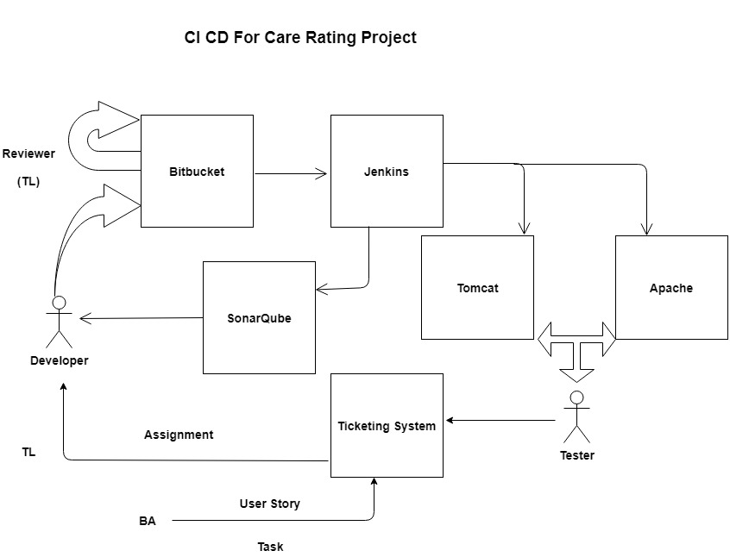
CI/CD Workflow

Slide 7
CI / CD step by step
Developers check out code into their local machines.
Developer commit changes to the source code repository.
Reviewer(TL) review the code and push to release branch
The CI server monitors the source code repository and starts build process.
The CI server builds the system and runs unit and integration tests.
The CI server releases deployable artifacts for testing.
The CI server assigns a build label to the version of the code it just built.
The CI server informs of the successful build.
If the build or tests fail, the CI server alerts the team.
The team fix the issue at the earliest opportunity.
Continue to continually integrate and test throughout the project
CI Server stage / Deploys to Production Environments (Can set up email based approval).

Slide 8
Tools Used
Tools | Options
Source Code Repository | Bitbucket
Continuous Integration Server | Jenkins
Code Analysis | Sonar Qube
Code Analysis Tools(for Java project) | Jacoco
Build Tools (Java and Angular) | Maven, NPM
Web Servers | Apache Tomcat 9.0 and Apache HTTP Server 2.4

Slide 9
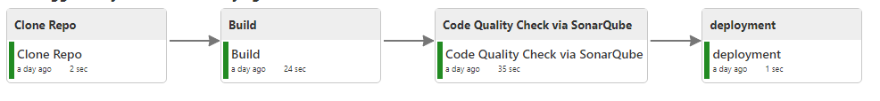
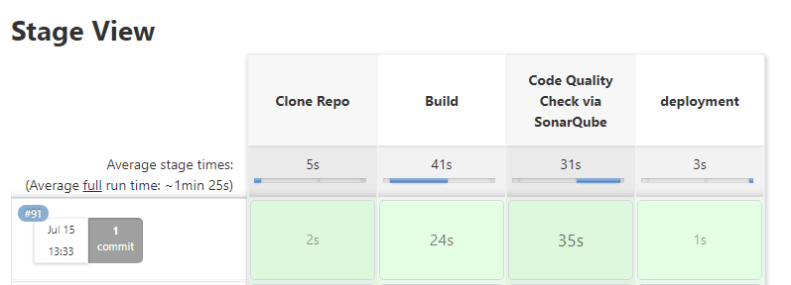
Jenkins Workflow for Java Project

Slide 10
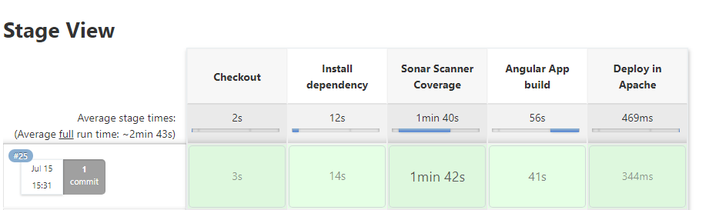
Jenkins Workflow for Angular project

Slide 11
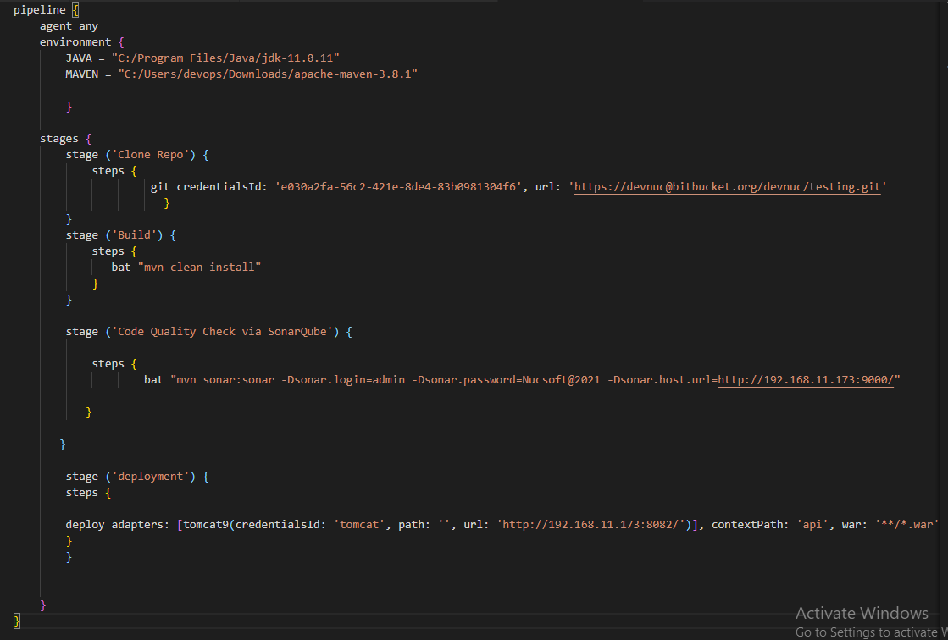
Jenkins Pipeline Script for Java Project

Slide 12
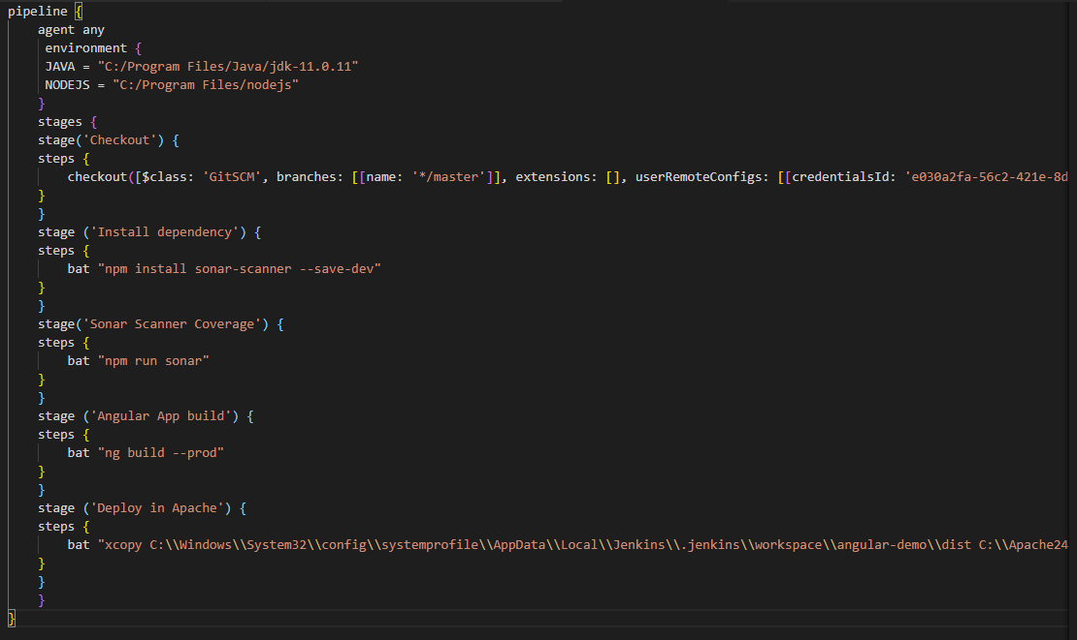
Jenkins Pipeline Script for Angular Project

Slide 13
Code Analysis Tools
JaCoCo
Used for Code Coverage. On the fly byte code instrumentation.
SonarQube
SonarSource for continuous inspection of code quality to perform automatic reviews with static analysis of code to detect bugs, code smells, and security vulnerabilities.

Slide 14
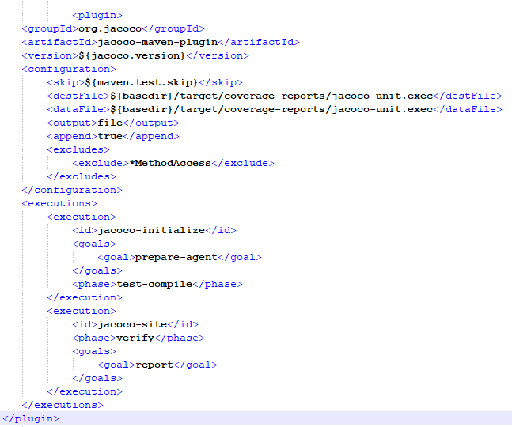
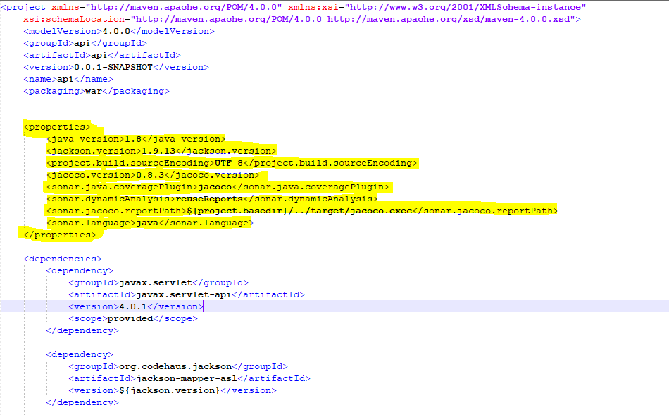
Code Analysis Tools - JaCoCo for Java Project
Add below changes in pom.xml file

Slide 15
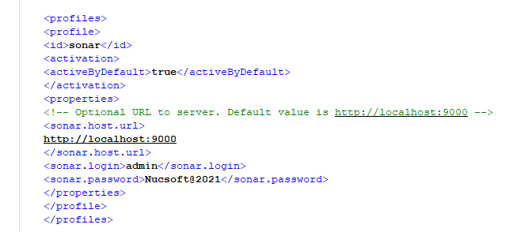
Code Analysis Tools - Sonar for Java Project
Add below changes in pom.xml file

Slide 16
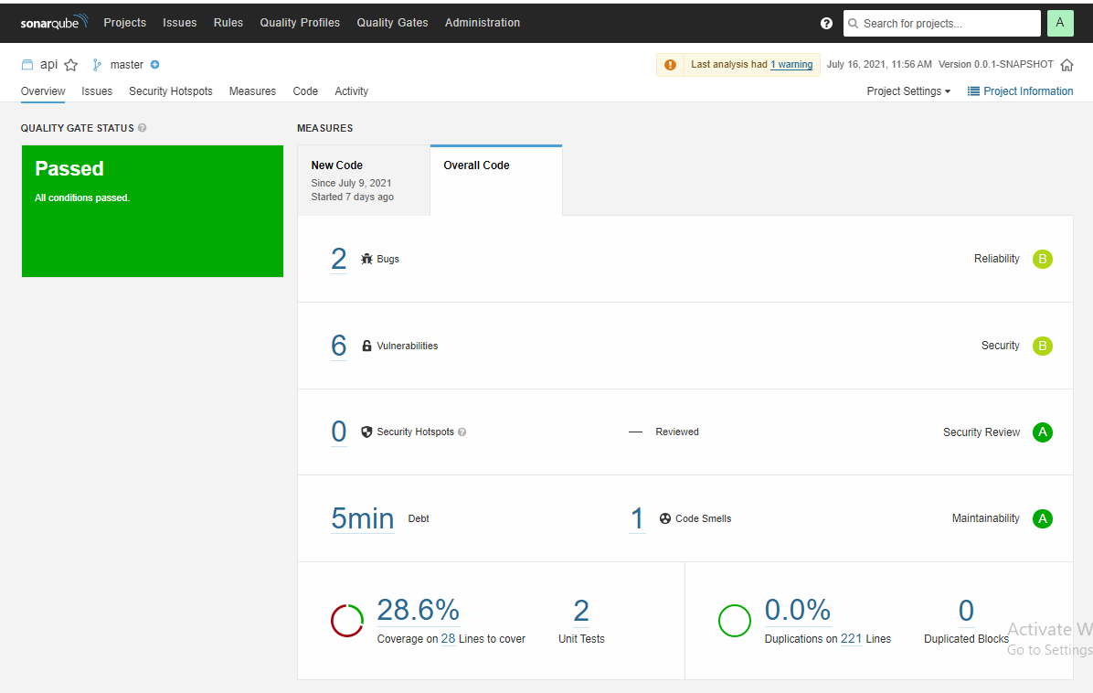
SONAR Dashboard for Java Project

Slide 17
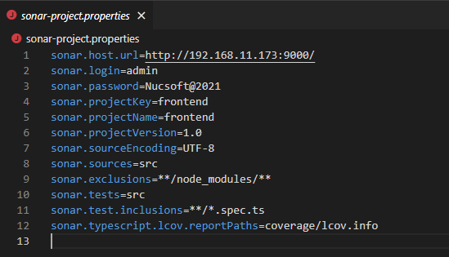
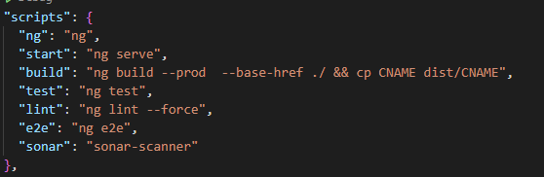
Code Analysis Tools - Sonar for Angular Project
Add below changes in package.jason file
Add below changes in sonar.properties file

Slide 18
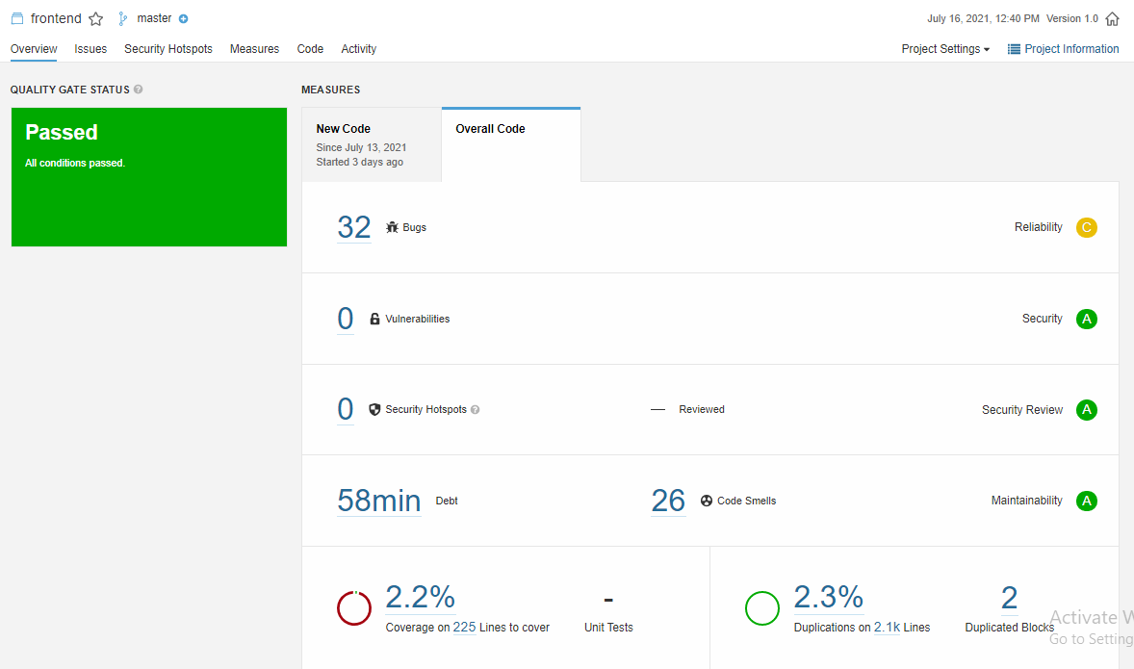
SONAR Dashboard for Angular Project

Slide 19
Great! what all plugins we have to used for Jenkins?
Bitbucket plugin to checkout source code from repo.
Bitbucket plugin for polling and start builds on each checkin.
Build Pipeline plugin.
Deploy to container plugin
Copy Artifacts Plugin
Email Extensions plugin
NodeJS plugin

Slide 20
Thank you so much!

